Slide 1
Uniform keyboard teaching assistant
C.M.R.M. part of the project
Notes:
BROWSER-BASED APPLICATION, AID IN LEARNING
ACTUAL PRACTICE ON PROPER KEYBOARD
ASSISTANT USED TO STUDY
SCALES, CHORDS AND HARMONY
My project consists of a browser-based application meant to aid music students in learning to play the uniform keyboard.
While the actual practice is done on a proper keyboard, this assistant is to be used for
studying how scales and chords fall on the keys, as well as the basics of harmony.

Slide 2
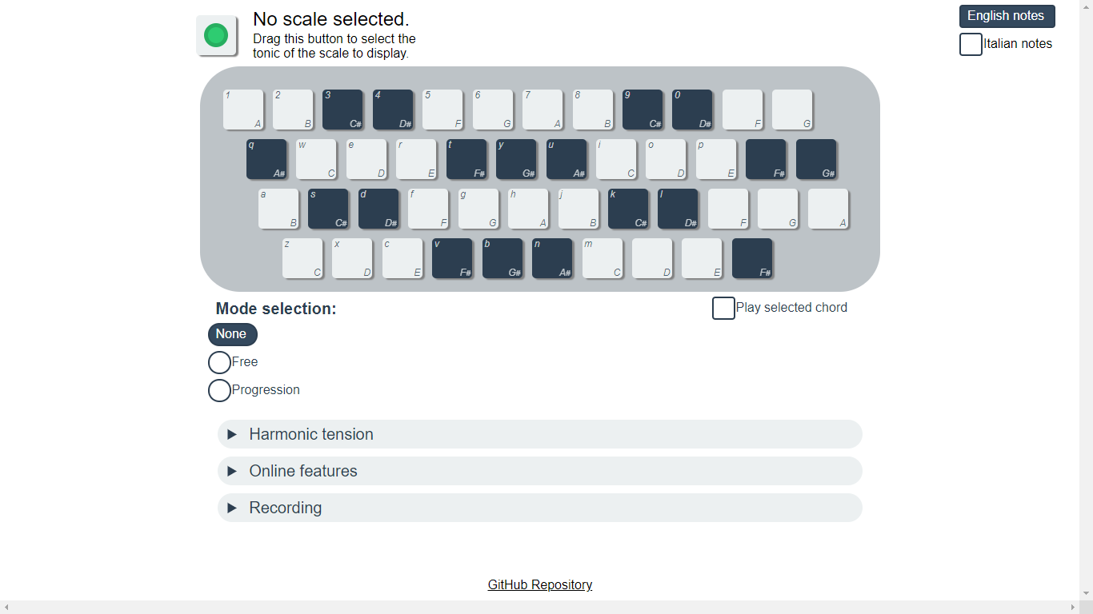
First look
Notes:
CLICK KEYS OR USE PC KEYBOARD
SETTINGS AROUND, FEATURES BELOW
Nevertheless, the keyboard can be played by clicking the keys or directly on the computer keyboard.
We'll go through the settings around the keyboard and the features under it.

Slide 3
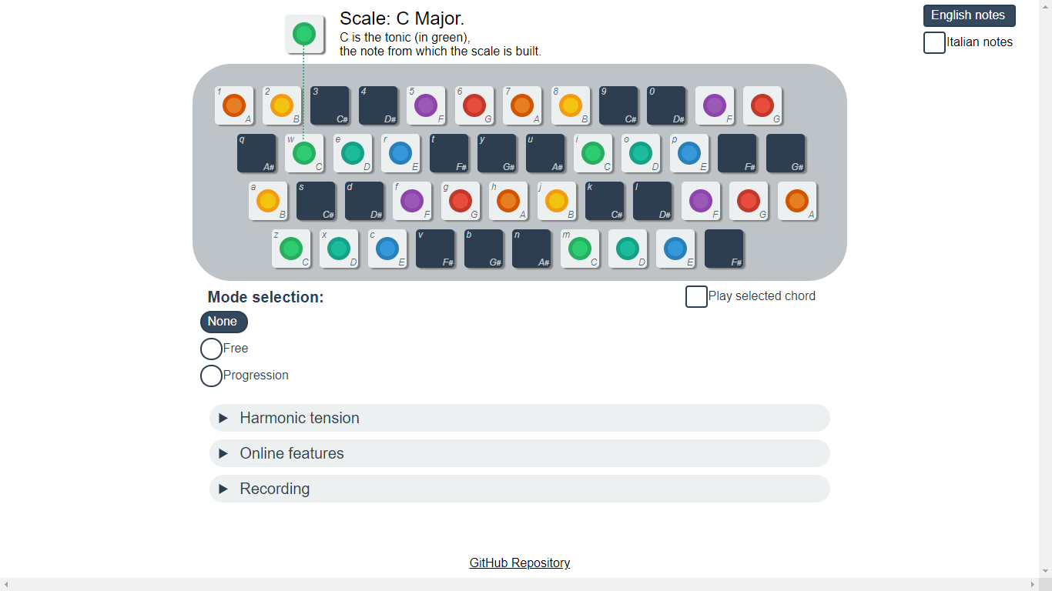
Scales
Notes:
CHOOSE SCALE WITH CURSOR
COLOR-CODED LABELS
GREEN IS TONIC
First of all, the scale can be chosen by sliding the cursor in the top left.
Scales are displayed by color-coded labels, with green denoting the tonic of the key, red the dominant, and so on.

Slide 4
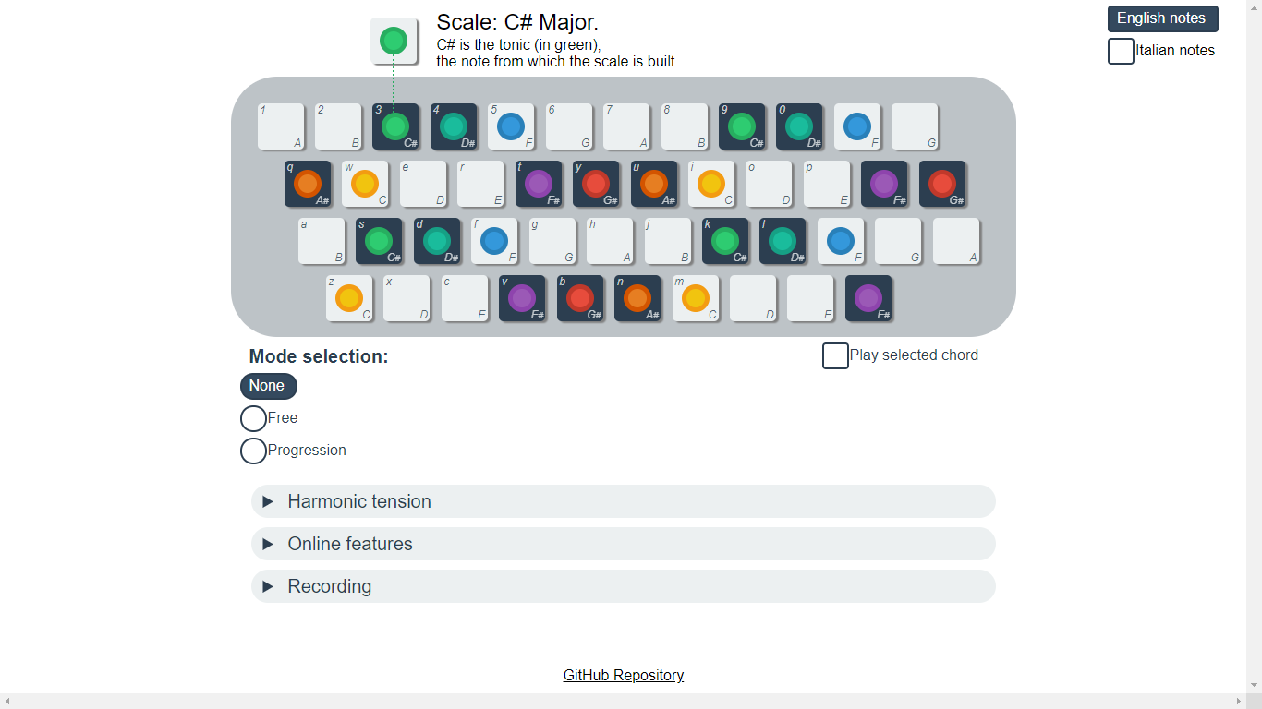
Changing scale
Notes:
LEARN WHAT B & W KEYS TO ADD AND DROP
EXPOSES SAME SHAPE
Sliding the scale over the keyboard shows what white and black keys are to be dropped or added,
and exposes how the same shape is shared by all scales of the same type (in this case, major).
These are C and C#.

Slide 5
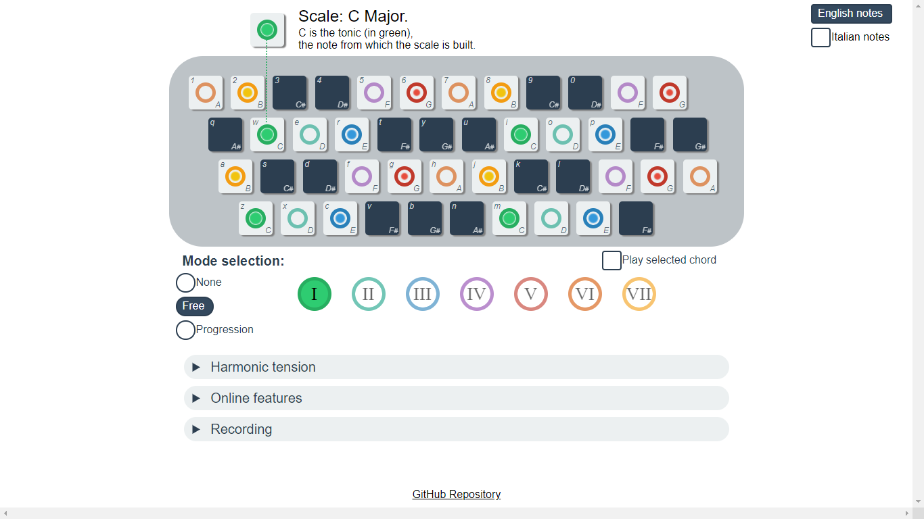
Modes
Notes:
SELECT DEGREE, HIGHLIGHTS ROOT 3 5 7
VISUAL WEIGHT:
IMPORTANCE IN CHARACTERIZING CHORD,
FIND QUICKLY
After choosing a scale, selecting a degree highlights its root, third, fifth, and seventh notes.
Visual weight is given in part based on the notes' importance in characterizing the chord,
and in part to allow the viewer to quickly localize each of them:
The root has the most weight and the fifth has the least, with the third and seventh in between.

Slide 6
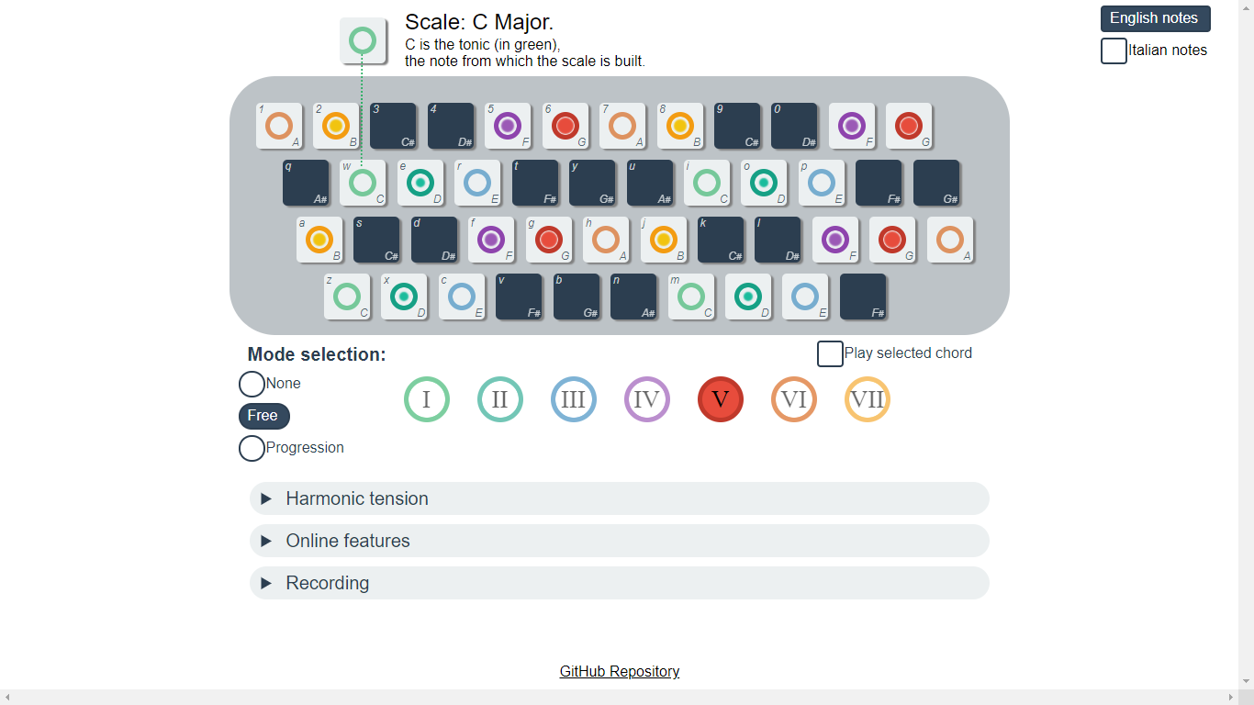
Changing Mode
Notes:
1° AND 5°
COLORS FIXED TO SCALE
These are the first and fifth degrees.
I chose to keep colors fixed to the scale, instead of moving them with the mode, so that green is always the tonic of the scale and not the root of the chord.
(The tonic chord takes the purest colors, red gree blue and yellow, while the mixed shades of teal, purple and orange are taken by its tension notes.)

Slide 7
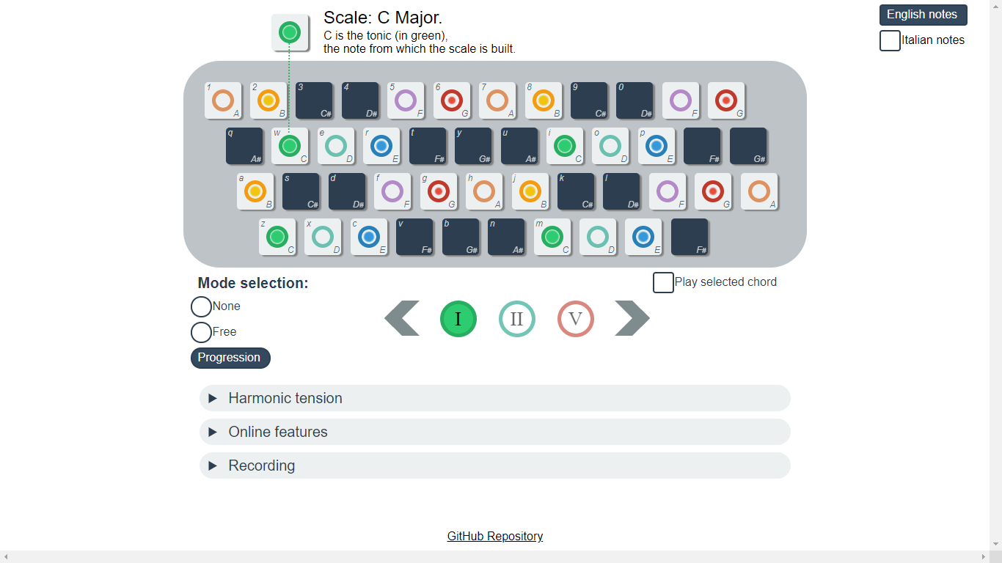
Changing Mode
Notes:
TWO METHODS 4 SELECTING
FREE MECHANIC, PROGRESSION MECHANIC
CLICK ICON, USE NUMPAD, PRESS SPACEBAR
There are two methods for selecting the degree.
With the free mechanic, all degrees are available; with the progression mechanic a common progression is suggested.
In both mechanics, the degree can be selected by clicking on its icon, choosing its index with the numpad, or pressing spacebar to advance to the next, which is really only useful for the progression mechanic.

Slide 8
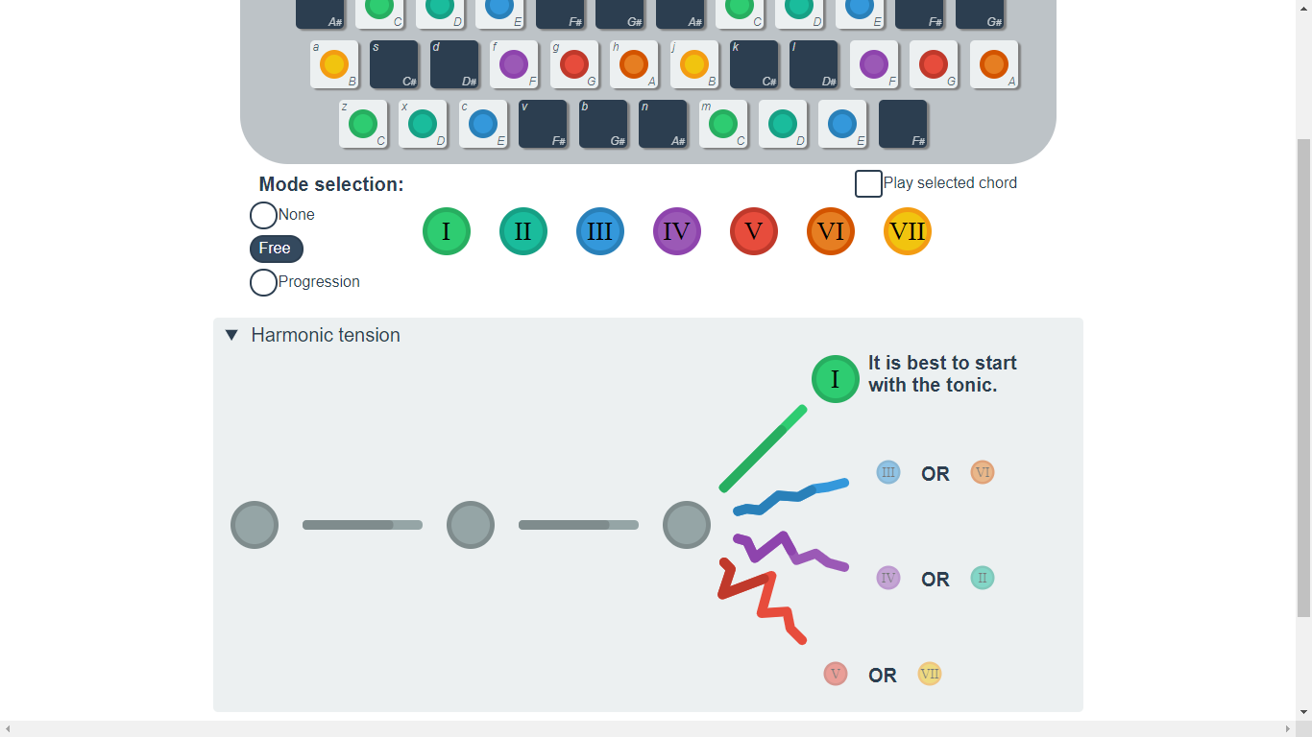
Harmonic tension
Notes:
MORE COMPLEX FEATURES: VISUAL. HARM. TENSION
REPRESENTED BY PULSES
NEXT POSSIBLE CHORDS, TENSION CONTRIBUTIONS
PREVIOUS CHORDS, TENSION BUILDUP
START -> PROMPTED TONIC
Moving on to the more complex features, this is the visualization for harmonic tension.
Tension is represented by these pulses:
on the right, we see the possible next chords and their related tension contributions;
on the left, previous chords and the tension buildup.
This is the start of the sequence, so the user is prompted to choose the tonic chord, but could choose to start from any chord.

Slide 9
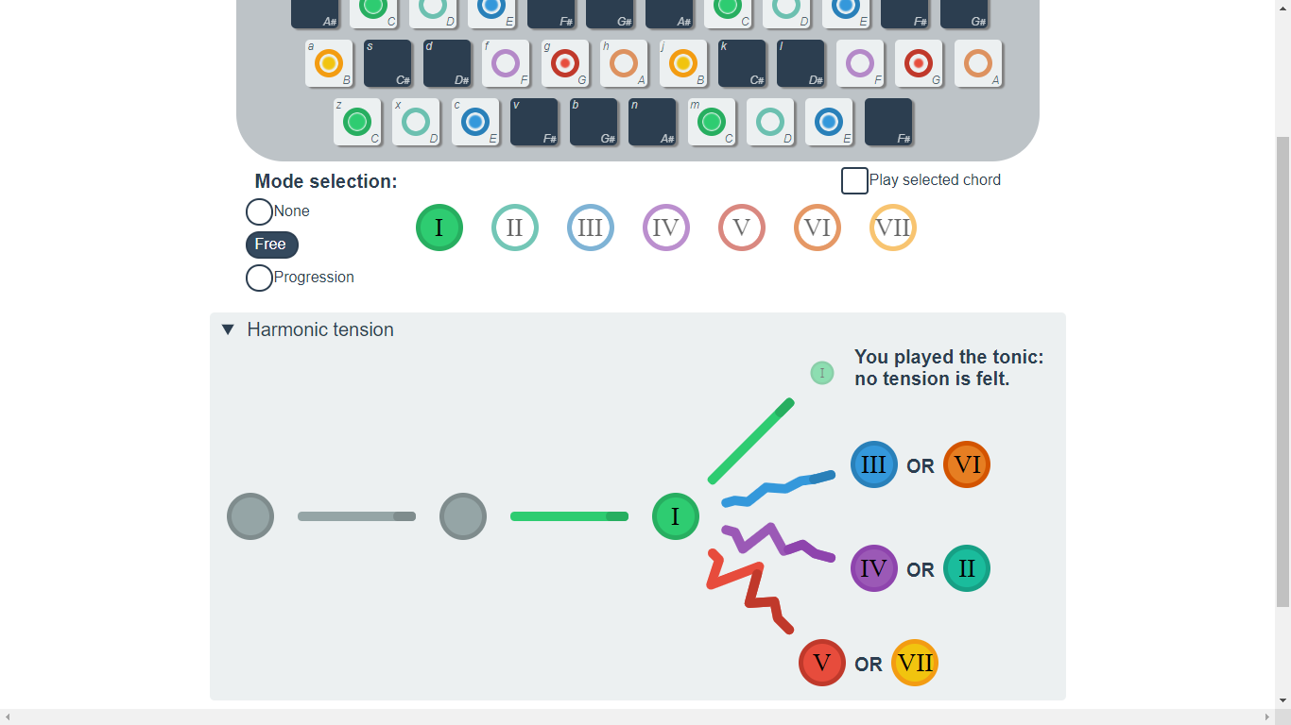
Harmonic tension
Notes:
FLAT TENSION
After picking the tonic chord, the flat tension is shown on the left;

Slide 10
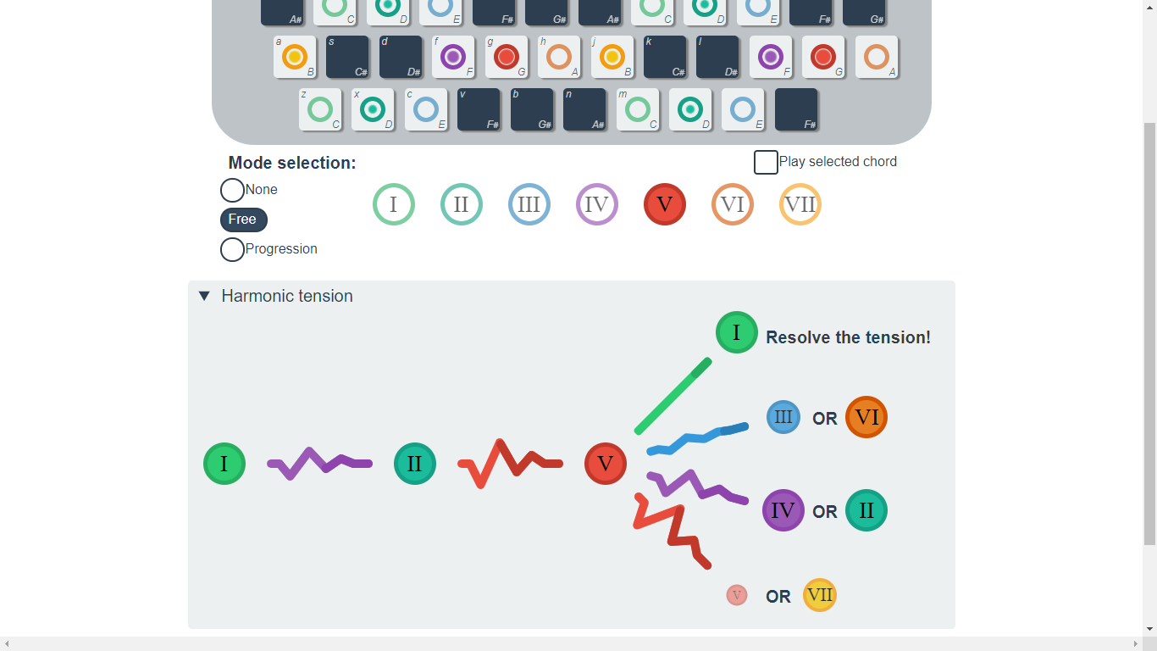
Harmonic tension
Notes:
2° 5° PROMPTED TO RESOLVE
DIFFERENT SIZES AND OPACITIES
CONSONANCE LATER
Picking the second and then the fifth, we can see that tension has risen and the user is urged to resolve to the tonic;
We can also see that the other chords have different sizes and opacities to show the consonance with the current chord
(we'll see how that is computed later).

Slide 11

Harmonic tension
Notes:
FEELING MESSAGE
If the user does resolve to the tonic, the feeling of resolution is noted under the tension flow,

Slide 12
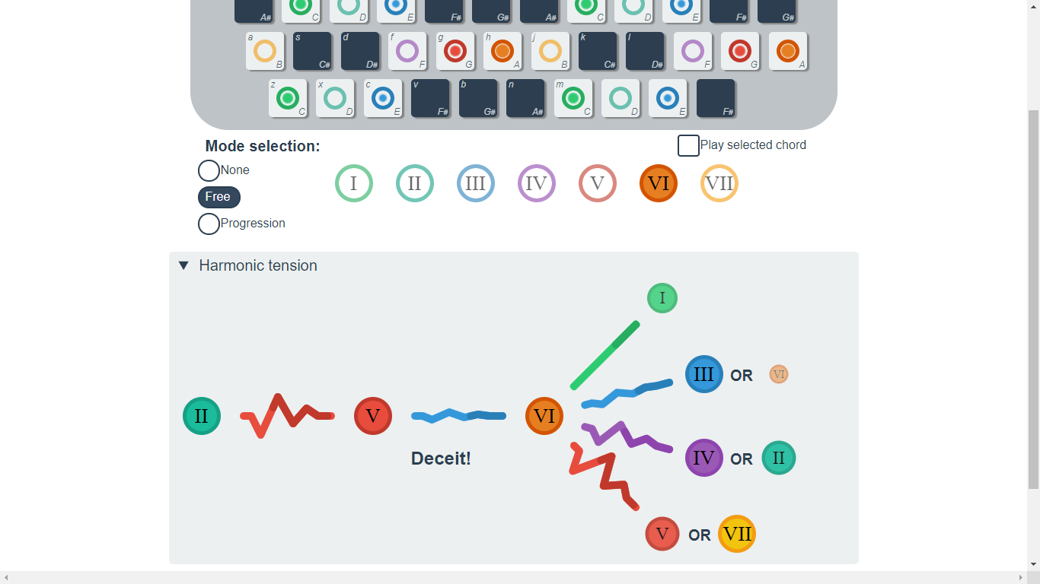
Harmonic tension
Notes:
DECEIVING CADENZA
and the same is done when completing a deceiving cadenza.

Slide 13
Sequence predictor
A Lempel-Ziv predictor was trained starting from the Ultimate Guitar annotated song dataset provided by the ISPG lab.
The dataset was trimmed down to songs exclusively consisting of
0:maj 2:min 4:min 5:maj 7:maj 9:min 11:min
(Major harmony, 26% of dataset)
The list was simplified converting semitones to degrees
'0' => 'I', '2' => 'II', '4' => 'III', ecc.
Adjacent repetitions of chords were eliminated.
For each n-long sequence that is present in the data, the number of appearances was counted.
Each n-long counter was compared to the n+1 counter, obtaining the probability of each possible next chord for any given sequence.
These were computed as percentages, formatted as JSON, and written to separate files (one for each sequence length).
"II V": {
"I": 68.08797713523002,
"II": 7.854686842601593, "III": 1.9934133213399683,
"IV": 14.695257301202721, "VI": 7.344001624907511,
"VII": 0.024663774718180105
},
"V I": {
"II": 4.531751415504169,
"III": 4.793763034980883,
"IV": 43.60297076082499,
"V": 26.447818286778325, "VI": 20.42971460559282, "VII": 0.1939818963188145
},
"I V": {
"I": 21.94099601568784,
"II": 8.068543886668454,
"III": 0.884155656289165, "IV": 31.669669969260315,
"VI": 37.382543849257075,
Notes:
EVALUATION PROBABILITY L-Z TREE, ULTIMATE GUITAR DATASET
TRIMMED DOWN MAJ HARMONY
SWITCHED NUMERALS
MANY LAYERS BUT USED ONE, CONSONANCE
USED PYTHON, EXAMPLE
The evaluation of the probability for the next chord is taken from a Lempel-Ziv tree trained on the Ultimate Guitar dataset.
I trimmed down the dataset to fit the Major-harmony-only nature of this application,
simplified the labels to roman numerals,
and prepared many layers of the tree although in the end I only used one,
using it as a measure of consonance between a chord and the next.
I did all of this in python, jupyter notebook to be exact.
Here is a sample from the second layer of the tree.

Slide 14
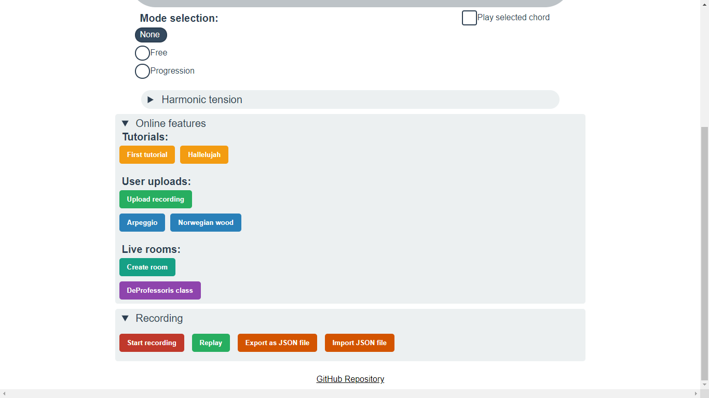
Online features
Notes:
ACTM PART, QUICKLY GO THROUGH THEN SMALL DEMO
TUTORIALS PRERECORDED STEPS, AUTOMAT. PLAY KEYS A/O MESSAGE
SPEED ADJUSTABLE, SKIP REPEAT
UPLOADED RECORDINGS, NO STEPS
LIVE ROOMS SPECTATORS ALMOST REAL TIME
RECORD SONGS, REPLAY, UPLOAD, EXPORT, IMPORT
These are the other features of the application, it's the Advanced Coding part of the project so I'll just quickly go through them and then we'll see a small demo of the live application.
Tutorials are pre-recorded lectures divided in steps, eache step consists of a sequence automatically played on the keyboard and/or an instructional message.
The playback speed is adjustable and it's possible to repeat or skip steps.
User uploads are recordings shared by other users, they don't have steps but again the speed is adjustable and repetition is possible.
Live rooms can be created by users, and spectators will see the host's keypresses and settings in (almost) real time.
There's a half second of latency, so playing together is not viable, but the relative delay between presses is preserved.
It is possible to record songs, which can be replayed, uploaded, exported as files, and imported later.

Slide 15
uniform-keyboard.firebaseapp.com
Let's see it in action.
Notes:
Now, I'll show you the application in action, although there isn't much we didn't cover already.
Slide scales around
Show some modes including play chord
Show the Hallelujah tutorial with tension
Point out how settings are locked
Record yankee doodle and upload it for the public to hear

Slide 16
Thank you for your time
Questions?

